Slide 1
Vivado HLS to Juptyer Notebooks Tutorial
Donal Conneely: 15378661

Slide 2
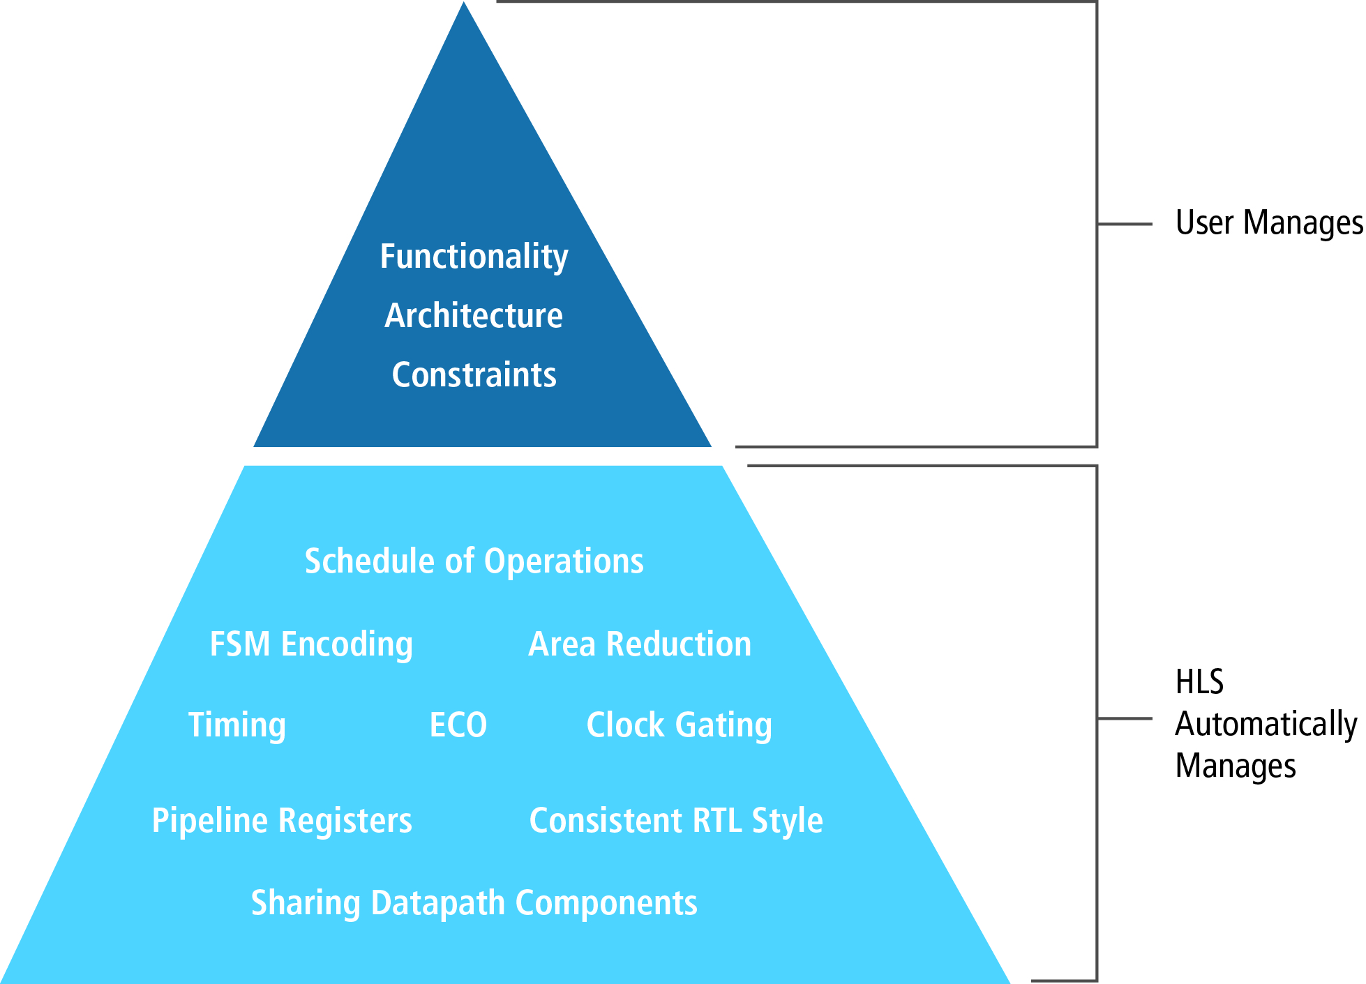
High Level Synthesis (HLS)
FPGAs are commonly programmed using Hardware Description Languages (HDLs), such as VHDL or Verilog. HDLs allow for a high degree of system control; however, they are often very verbose and time-consuming.
High-Level Synthesis (HLS):
HLS is a method of parsing existing high-level programming languages, such as C/C++, into Hardware Description Languages (HDLs) used to program FPGAs.
HLS operates as a form of design automation, allowing the designer to focus on the specific application requirements instead of focusing on the specific requirements of the target platform.
Notes:
FPGAs are commonly programmed using Hardware Description Languages (HDLs), such as VHDL or Verilog.
HDLs allow for a high degree of system control; however, they are often very verbose and time-consuming.
Therefore a alternative was developed HLS
While this does reduce the customization potential of standard HDLs, it allows for the use of the FPGAs increased energy efficiency, without the time delays associated with converting an algorithm to an HDL by hand.

Slide 3
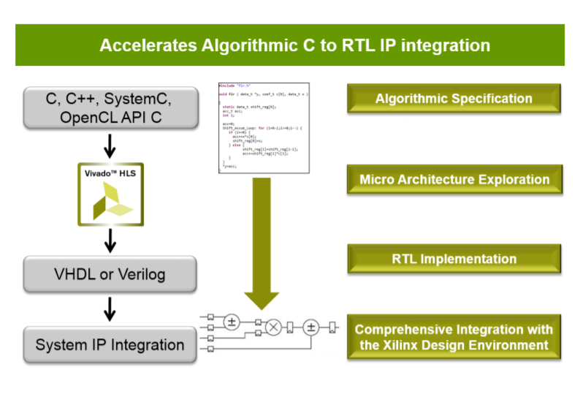
Vivado HLS Basics
High-Level Synthesis
Creates an RTL implementation from C, C++, System C, OpenCL API C kernel code.
Extracts control and dataflow from the source code.
Implements the design based on defaults and user applied directives.

Slide 4

Languages Supported
A Complete C Validation & Verification Environment
Vivado HLS supports complete bit-accurate validation of the C model
Vivado HLS provides a productive C-RTL co-simulation verification solution
Vivado HLS supports C, C++, SystemC and OpenCL API C kernel
Functions can be written in any version of C
Wide support for coding constructs in all three variants of C
Modelling with bit-accuracy
Supports arbitrary precision types for all input languages
Allowing the exact bit-widths to be modelled and synthesized
Floating point support
Support for OpenCV functions

Slide 5

Setting PYNQ Board on HLS
In order to use the PYNQ with HLS, you must set the board files in both Vivado HLS and the Vivado Design Suite:
For Vivado Design Suite:
Close Vivado.
Download the Board File. (https://pynq.readthedocs.io/en/v2.3/overlay_design_methodology/board_settings.html)
Extract and Copy Board Files to: Directory\Xillinx\Vivado\Version\data\boards\board_files
(Directory: Directory Xilinx installed on User Computer, Version: Current Vivado Version e.g. 2018.2).
For Vivado HLS:
Close Vivado HLS.
Go to: Directory\Xillinx\Vivado\Version\common\config
(Directory: Directory Xilinx installed on User Computer, Version: Current Vivado Version e.g. 2018.2).
Open VivadoHls_boards.xml using Text Editor.
Add Board Details (e.g. PYNQ-Z2: )

Slide 6
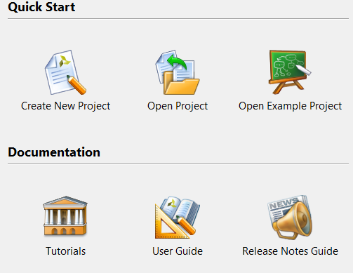
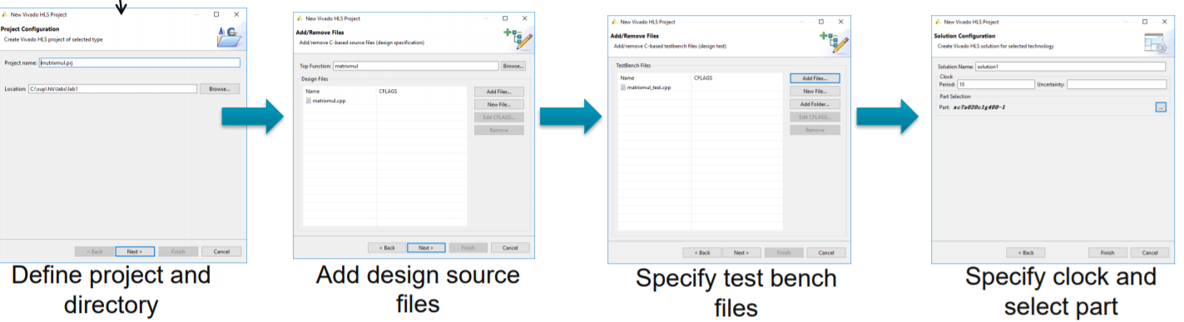
Using Vivado HLS
Enter Project Name
(Best to use given directory as other directories can cause errors)
Add Existing Design Sources and Define Top Function (Best to leave blank and add Function later, then set Top Function once Coded).
Add Test Bench Files.
(Again best to code from within system due to file management errors and set as testbench later)
Select Desired Technology to be used

Slide 7
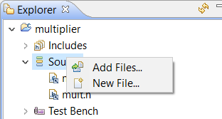
Using Vivado HLS (Cont..)
Adding Files
Minimum 3 Files Needed for System:
The Design File (Defines Component Functions).
The Testbench (Defines System Test).
The Header File (Links the Testbench to the Design File so that tests can be performed).

Slide 8
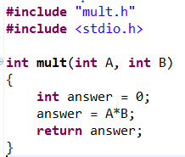
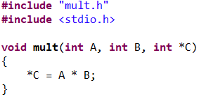
Design File (.C or .CPP)
Coded in standard C/C++, No special requirements for coding.
Any additional optimization techniques are optional and appear to be up to user input (e.g. Loop Unrolling and Pipelining).
Finally according to documentation most C/C++ libraries should be compatible with Vivado HLS. In particular OpenCV is noted as having support.
It is important to note the lack of the return statement.
In typical C/C++ programming the return statement is used to output the final value.
Vivado HLS code represents a hardware implementation of the application. In hardware there is no such thing a blanket return statement, all values must be returned along a specified port.
Instead the system must take in a pointer (address) to the desired output location.

Slide 9
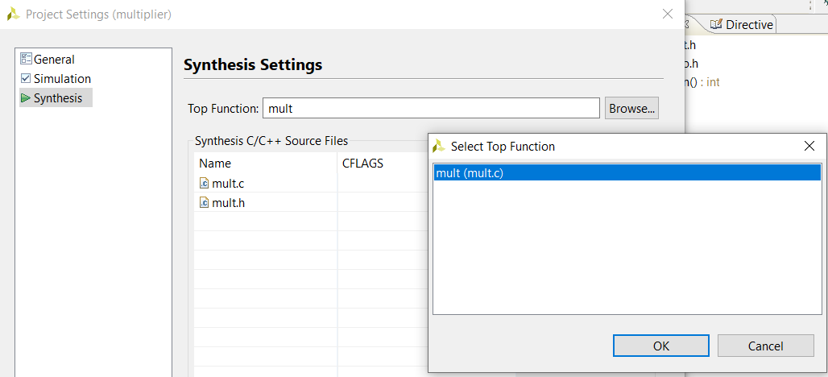
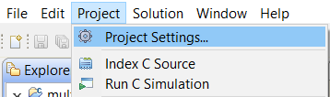
Design File (.C or .CPP) (Cont..)
The user must set which file/function is the top function, i.e. the function targeted by the testbench for testing.
To do this Right-Click on the Project to access the Project Settings -> Synthesis.
Then select the Top Function. (Note the system will list all functions within the C file, so you must chose the outer most function).

Slide 10
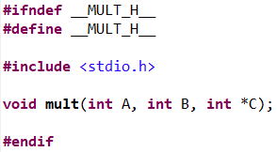
Header File (.H)
A single header file is required.
This file acts as the link to match the Testbench to the Design File, otherwise the Testbench cannot operate.
Acts as a import in C/C++. Using this the user can define functions that the Testbench is allowed to call from the Design File.
Additionally can be used to define constant values or user defined Variable Types for use in any file which imports the Header.

Slide 11
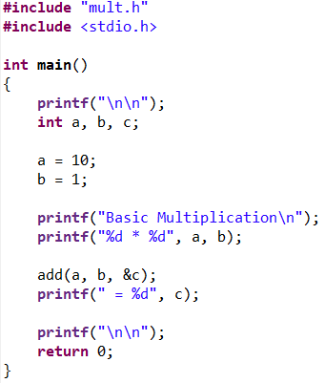
Testbench File (.C or .CPP)
Tests the Design File.
Must include reference to the Top design file.

Slide 12
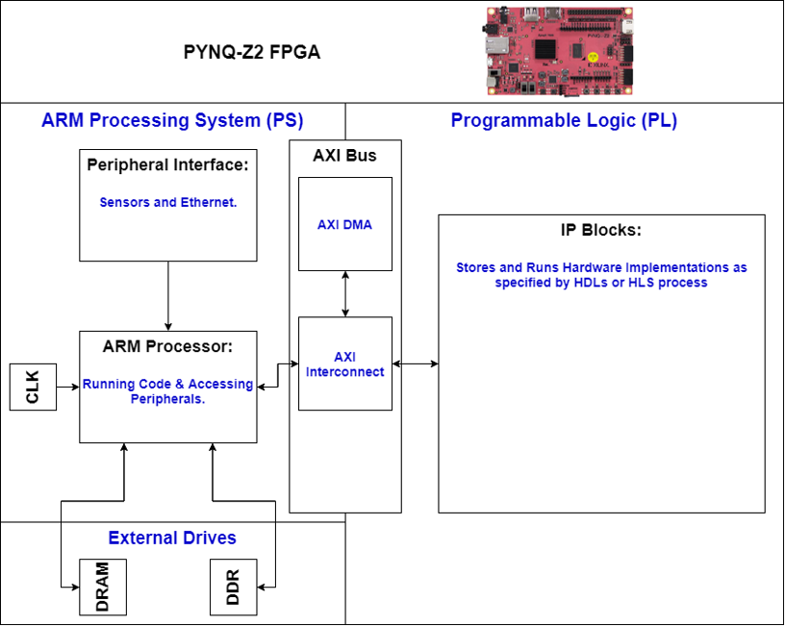
AXI (Advanced eXtensible Interface)
FPGAs are typically broken into two primary parts: The Processing System (PS) and The Programmable Logic (PL).
The PS component runs the code and handles communication with external devices, such as sensors. This components acts similar to a microcontroller device.
The PL is where the IP Blocks generated by the HDLs are stored. These IP Blocks are programmed by the HDLs to mimic the functionality of Hardware Implementations.
In order the communicate between the two components the system must use what is known as the Advanced eXtensible Interface (AXI).
The AXI bus is the primary gateway between the two parts of the FPGA.
There are two types of AXI: AXI4 Memory Map and AXI-Stream.

Slide 13
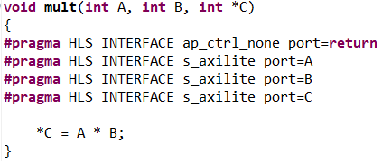
AXI4-Memory Mapped
In AXI4 Memory Map, the system describes communication between a single AXI master and an AXI slave.
The master selects the specific memory address that they wish to send data two.
Both the sender and receiver must keep track of the exact memory location in use.
AXI4 Memory Map breaks down into two types, AXI4 and AXI4-Lite.
AXI4 deals with memory mapping of large values and is designed for high-performance memory-mapped requirements.
AXI4-Lite is a designed for more simplistic data, typically single integer values and is utilized for the single bit memory map transactions.
In Vivado HLS to use the AXI the relevant pragmas must be added to the Design File (This is an AXI-Lite Example).
(Note the return value cannot be used across AXI as it is used as an ap control system, therefore the design must take the Output line(s) as an input. The default value is ap_ctrl_none).

Slide 14
AXI-Stream
The AXI-Stream interface relates to transmission of data that is continuous or must be kept together in some way.
Example Voice or Video data.
This data is sent in the form of packets rather than single values.
AXI-Stream removes the requirement for specific memory addressing. Instead the data passes through what is known as the AXI Direct Memory Access (AXI-DMA).
This system acts as a form of register buffer, transferring streams of bytes between the PS and a pre-set location in memory.
The advantage of AXI-Stream is that the system does not need to manage the specific memory address for each byte of data, and the system is guaranteed to wait for all values to complete before moving to the next step.
The disadvantage of AXI-Stream is each individual AXI-Stream transmission (packets) have a set maximum size.

Slide 15
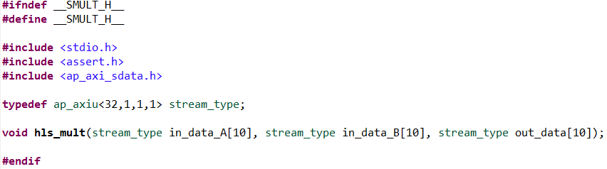
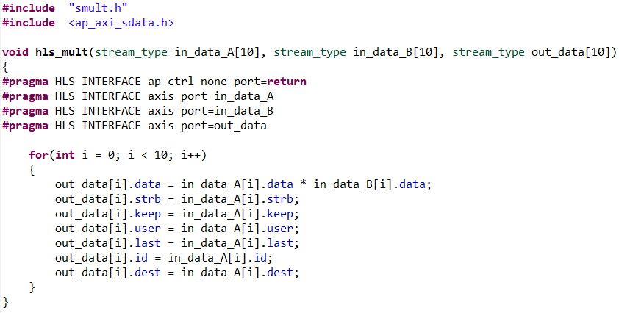
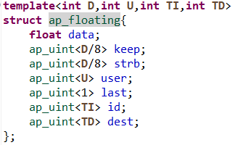
AXI-Stream (Cont..)
AXI-Stream Header File
To use the AXI the relevant pragmas must be added to the Design File.
Unlike AXI4-Memory mapped, AXI-Stream requires the use of specific Stream Data Types. These stream types store the data value as well as several other ap values.
The ap values are designed to ensure the stream is read in the correct order at the other side.
These values include strb, keep, user, last and id and dest.
For this example the in-built ap_axiu stream type was used, but custom stream data types can be created using a C struct using the same template as the ap_axiu.
The stream data type must be imported into the Header File of the project.
AXI-Stream Design File
Custom Stream Type

Slide 16
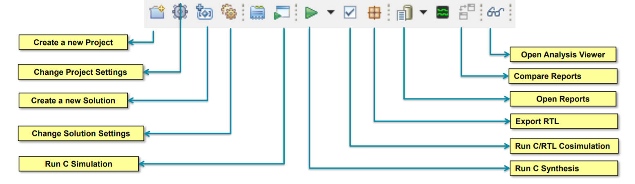
Vivado HLS Functions
C Synthesis must be performed before Simulation/Co-Simulation (Creates VHDL, SystemC & Verilog Files).
C Simulation runs the testbench file using a C/C++ emulator only.
C/RTL Co-Simulation runs the C simulation and runs either the VHDL or Verilog Version (your choice), comparing results to see if output is correct.

Slide 17
RTL Export
RTL Export, Two Export Types:
IP-XACT formatted IP for use with Vivado System Edition (SE)
7 Series and Zynq families only; supported by HLS and VIVADO_HLS licenses
A System Generator IP block
7 Series and Zynq families only; supported by HLS and VIVADO_HLS licenses

Slide 18
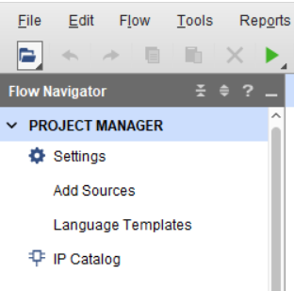
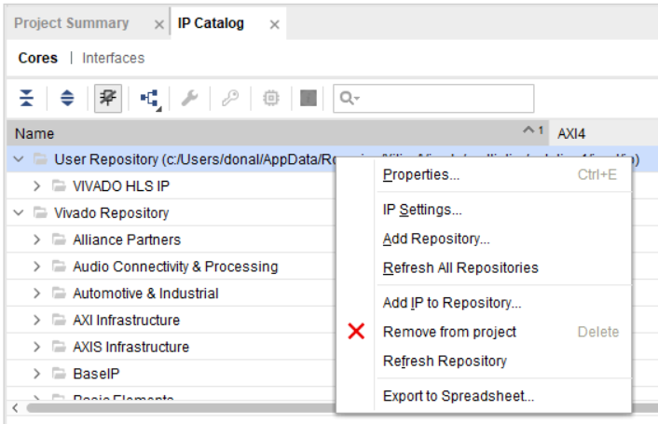
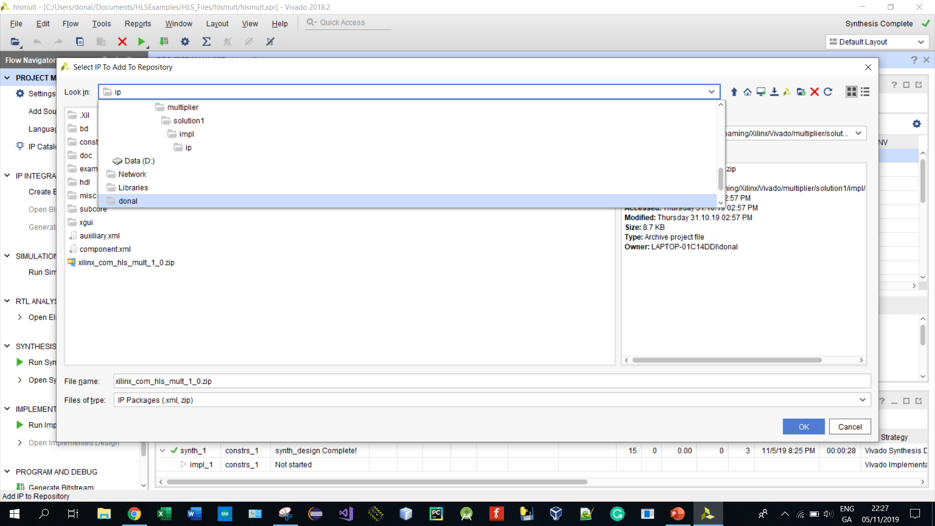
Importing to Vivado Design Suite
Vivado HLS does not create it’s own Vivado Project:
Create an Empty Project using desired technology.
Two Import Methods Methods:
Method 1: Using RTL Export to Generate IP Block.
When you generate the IP Block you can import that block into the Vivado Design Suite, using the IP Catalog.
Note if you import the file in this way you will be unable to edit the VHDL/Verliog generated by HLS.

Slide 19
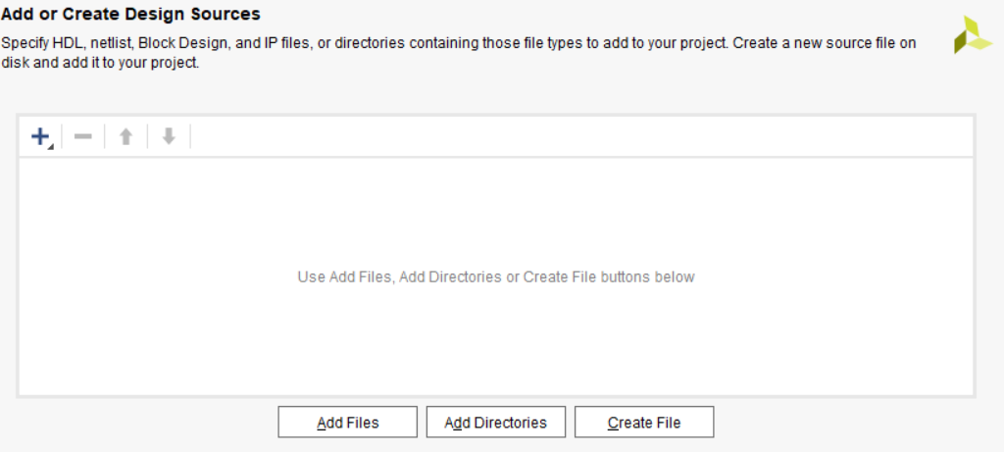
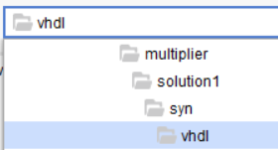
Importing to Vivado (Cont..)
Method 2: Adding the VHDL file as a source:
Note that if you import the VHDL this way you can edit the VHDL, but will be required to generate the IP block using the Vivado Design Suite.

Slide 20
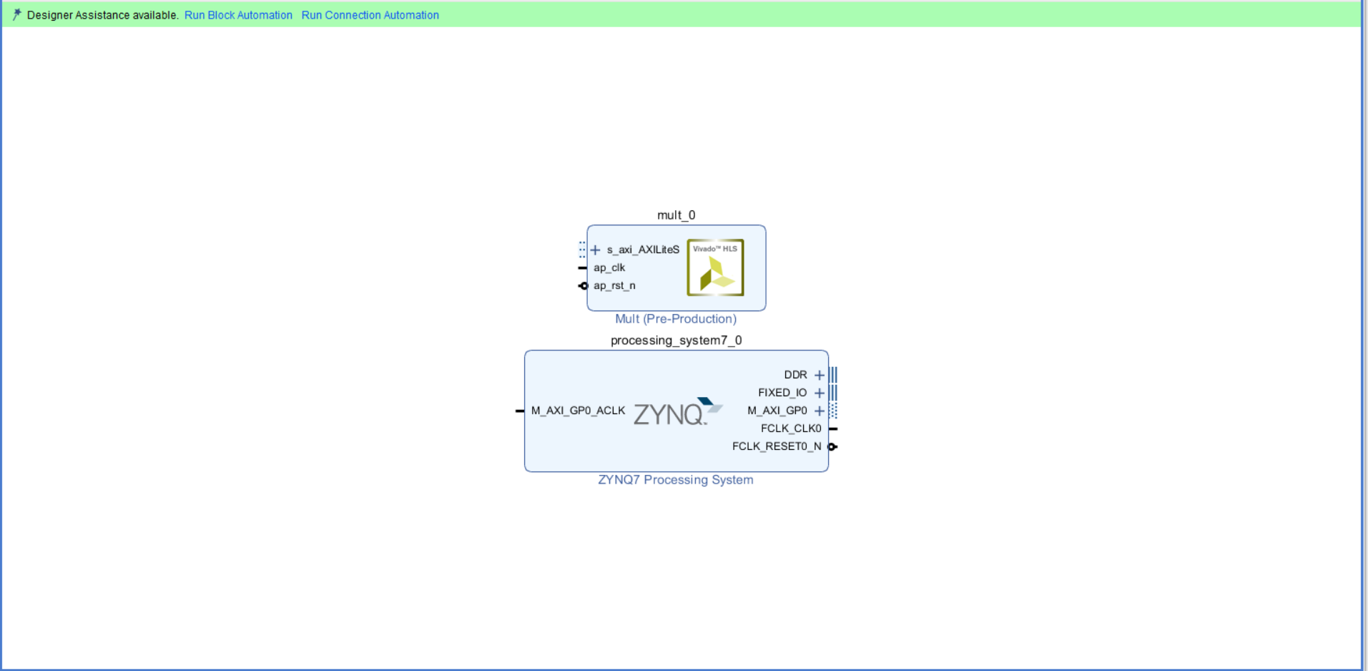
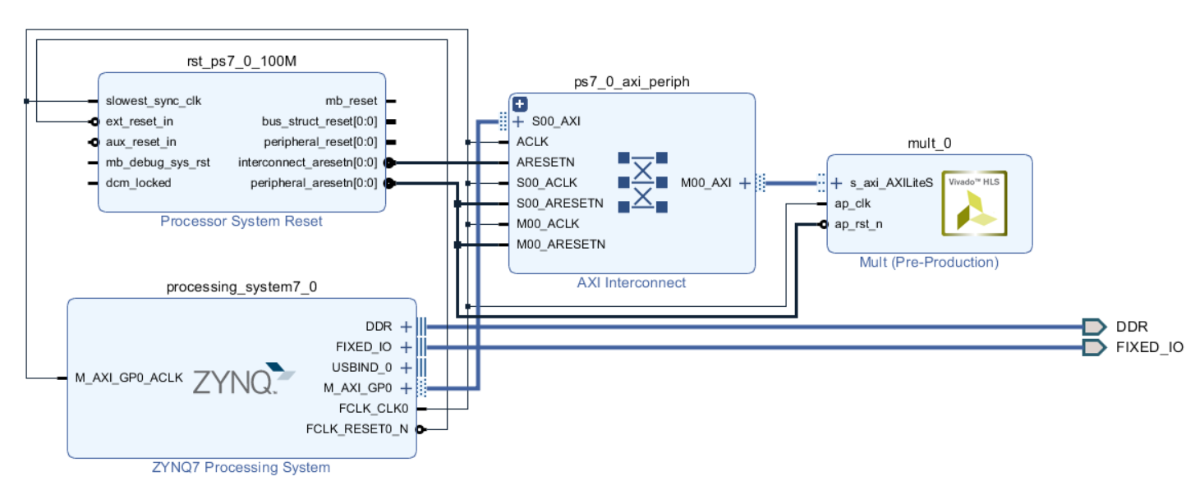
Block Design (AXI-Lite Connections)
Once the IP for the design has been generated/imported in Vivado, you must then connect the design to the ZYNQ Processor.
In Vivado Select Create Block Design, and add the ZYNQ Processor and your custom IP. Then run block automation & connection automation.
The Vivado HLS IP uses a different clock frequency (default 100 MHz), the ZYNQ-7 Processor must be configured to run using the new frequency. This can be done by using the Customize Block function.
This change must be made After the user runs the Run Block Automation command, but Before they run the Run Connection Automation
The Run Block Automation defaults the clock to 100MHz.
The Run Connection Automation builds the Processing System Reset based on the current clock frequency

Slide 21
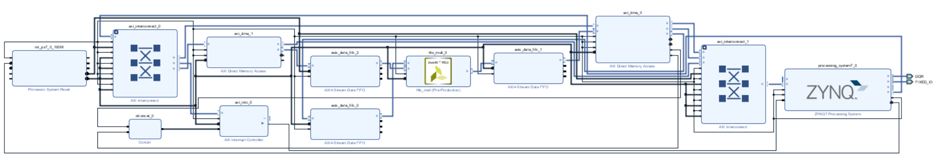
Block Design (AXI-Stream Connections)
For an AXI-Stream design the system must make use of the AXI-DMA component.
The ZYNQ Block must be customized to add an additional AXI-Stream compatible port (HP0) and an Interrupt Port.
Additionally, the system must buffer the stream before accessing the data. To do this the system passes each line through AXI-Stream Data FIFO.
The AXI DMA requires that an AXI-Interrupt Controller. As there are two DMAs their interrupt lines are concatenated together before being passed to the Interrupt Controller.

Slide 22
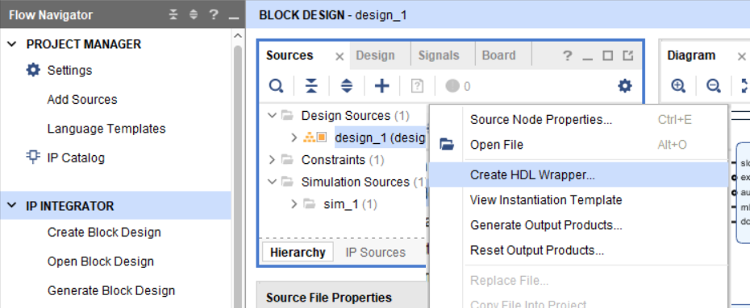
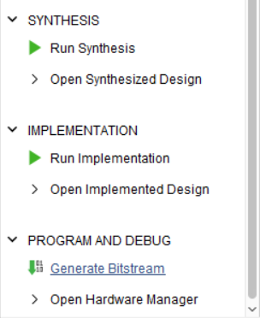
Bitstream Generation
Once the Block Diagram is complete, you must then create a VHDL Wrapper, which denotes all the connections of your design.
Once the wrapper has been created you can generate the bitstream by pressing the Generate Bitstream button, which will perform Synthesis, Implementation and Bitstream Generation.

Slide 23

Juptyer Notebooks Setup
Once the design has been completed and the Bitstream has been generated we can move to uploading the design to the board via Juptyer Notebooks.
Firstly, the user must setup both the Pynq Board and the Juptyer Notebooks by following the Tutorial at the link below:
https://pynq.readthedocs.io/en/v2.3/getting_started.html

Slide 24


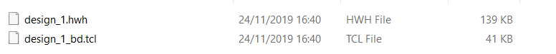
Using Design on Juptyer Notebooks
Once the Juptyer Notebooks has been setup you can then use this system to run your custom IP on the FPGA.
To do this you must first copy files from your design into the Pynq connection.
Create a Folder for the project at \\192.168.2.99\xilinx (Username: xilinx, Password: xilinx).
First go to The File Directory of your project from Vivado Design Suite: File Directory\projectname.srcs\sources_1\bd\design_1\hw_handoff.
Copy the .hwh file into the folder in \\192.168.2.99\xilinx

Slide 25

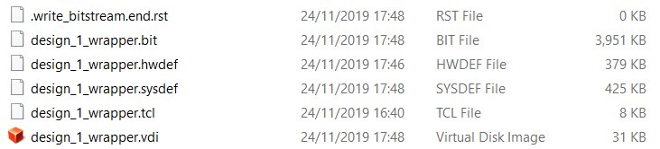
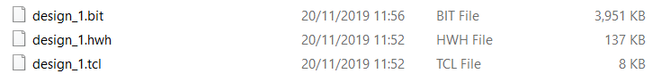
Using Design on Juptyer Notebooks (Cont..)
Continuing from last slide:
First go to The File Directory of your project from Vivado Design Suite: File Directory\projectname.runs\impl_1.
Copy the .bit file and the .tcl file into the folder in \\192.168.2.99\xilinx
In the folder in \\192.168.2.99\xilinx rename the .bit and .tcl files so their names match the .hwh file:

Slide 26
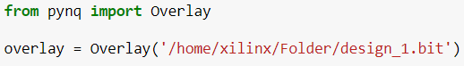

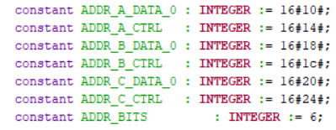
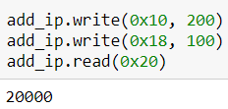
Using Design on Juptyer Notebooks (Cont..)
Once the files are in the correct location go to Jupter Notebooks online (http://192.168.2.99)
From there create a PYTHON 3 file and code as follows (AXI-Lite):
First import the Pynq Overlay library and set the overlay to the bitfile location:
Once the Overlay has been set you must then select the IP you wish to test. As seen from the Vivado Block Diagram the multiplier has been labelled as mult_0.
Once that is done you can read/write to the input/output of the IP. Reading the VHDL for the mult_0 will tell you the addresses you need to reference. See an example below (100 x 200 = 20,000).

Slide 27
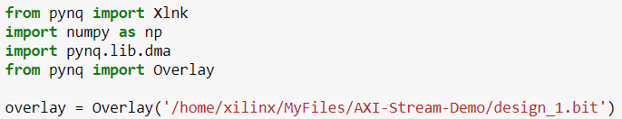
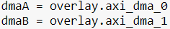
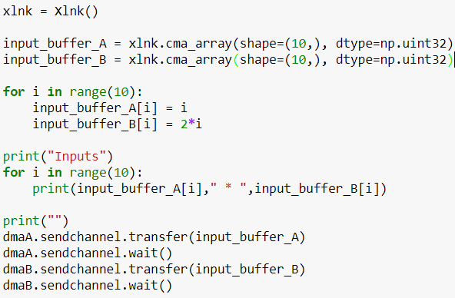
Juptyer Notebooks AXI-Stream
For the AXI-Stream example the Python code is slightly altered.
First import the Pynq Overlay and DMA libraries and set the overlay to the bitfile location:
Once the Overlay has been set, the DMAs must be targeted for data transfer:
Once that is done you can transfer data into the DMA. The data must be formatted as a cma_array:

Slide 28
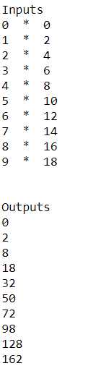
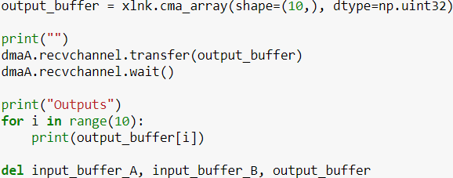
Juptyer Notebooks AXI-Stream (Cont..)
Finally once the input transfer is complete the output stream can be read out:

